Slide 1
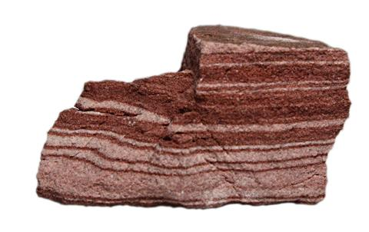
Daily Review
Rocks can be identified using their physical properties. The properties geologist use are: colour, layers, grains or crystals, and holes.
On your whiteboard, use those 4 properties to describe the rock in the picture.

Slide 2
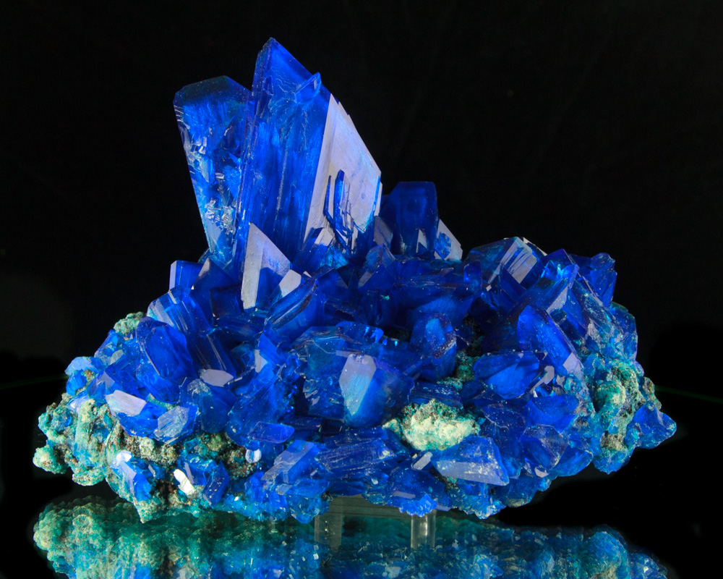
Daily Review
Minerals can be identified using their physical properties.
One physical property geologists look at is the lustre (shininess) of the mineral. A mineral can be classed as metallic, pearly, glassy or dull.
Think, Pair, Share: What is the lustre of this mineral?

Slide 3
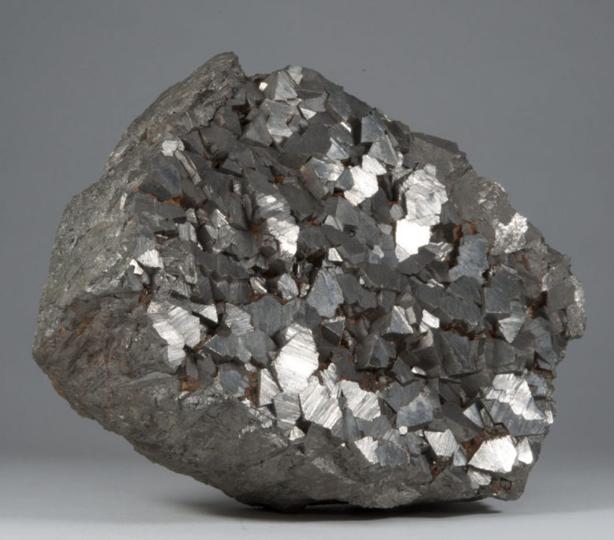
Daily Review
Minerals can be identified using their physical properties.
One physical property geologists look at is the lustre (shininess) of the mineral. A mineral can be classed as metallic, pearly, glassy or dull.
Think, Pair, Share: What is the lustre of this mineral?

Slide 4
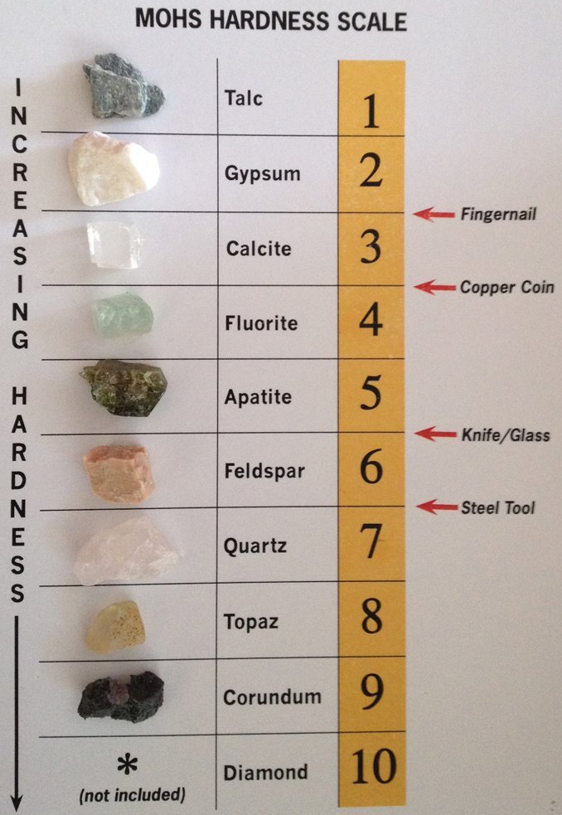
Daily Review
Minerals can be identified using their physical properties.
Another physical property geologists look at is the hardness of the mineral.
The Mohs’ Scale of Hardness is used to compare the hardness of a mineral.
Think, Pair, Share: A mineral can be scratched by feldspar, but will scratch fluorite. What is its hardness?

